Slide 1



Python Fundamentals
Innovation Masters
Day 1

Slide 2
What will we do in the course?
How to talk to computers
Learn about the most fundamental concepts of programming
The fundamentals are transferrable to other languages as well
Make programs together in class and by yourself
Discuss new tech innovations (Tech Talk)
Explore a new field of study and just have fun

Slide 3
Who am I?
Rifat Alam (Rif)
Mechanical Engineering and Computer Science
Want to make my own school in the future
Some hobbies/interests: playing soccer, sketching/painting, playing music, badminton, Robotics, reading books, anime/movies/shows, used to play a lot of video games when I was young, meeting new people

Slide 4
Let’s get to know the class
Feel free to share what you want to
Here are some points to help you:
Name and age/school grade
What subjects do you find interesting?
Music?
Anime?
Video Game?
Favorite Superhero?
Sports?

Slide 5
Essence of the Classroom
I am your friend and I’ll share with you the knowledge and experience I have gathered and will learn from you.
Not here to lecture you but more like explore the topics with you.
We will make a nurturing and comfortable environment where we learn and grow together.
We will actively participate and have fun!

Slide 6
Classroom Etiquette
We respect each other.
Keep mic muted if you aren’t speaking.
We will try to sit in a quiet and distraction free room during class.
Don’t feel shy about asking questions if something isn’t clear.
If possible, let’s share our videos

Slide 7

Intro to Computer Science
What is computer science?
Simply put it is the study of computers and how to make programs and applications.
Why is it significant?
Computers can do calculations with tremendous speed and accuracy.
Starting from phones to robots, most of the gadgets around us today are fruits of computer science.

Slide 8
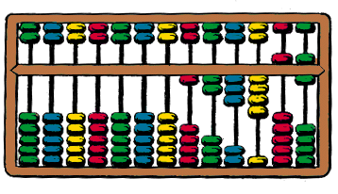
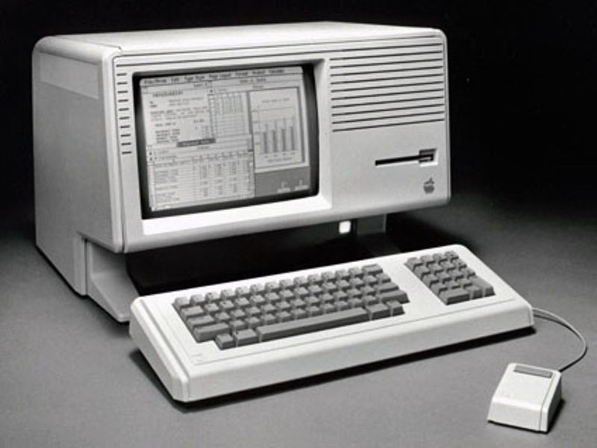
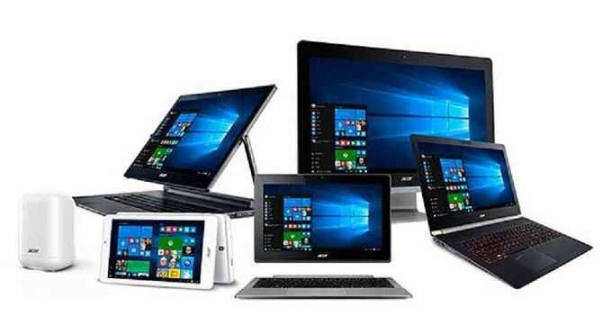
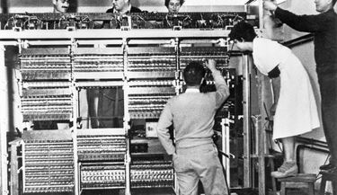
Where did it begin?
Computers at their earliest were simply calculators
All they did was process numeric calculations, that a human might have made errors in
Technology saw exponential growth in the 1900’s and in a very short time our computers became what they are today

Slide 9
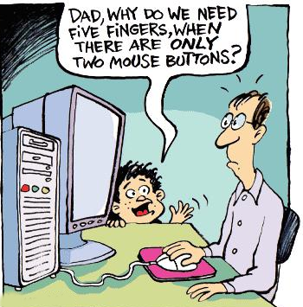
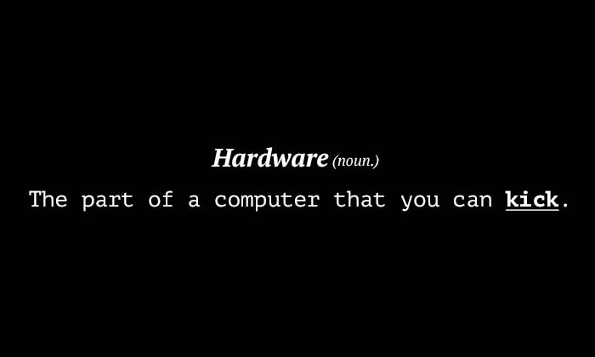

Software and Hardware
A computer has two components
Hardware- the physical parts of a computer that you can touch
Ex: Cooler fan, mouse, monitor, analogy- human body
Software- does processing or tells the hardware what to do
Ex: Game, video, application, analogy- human brain

Slide 10

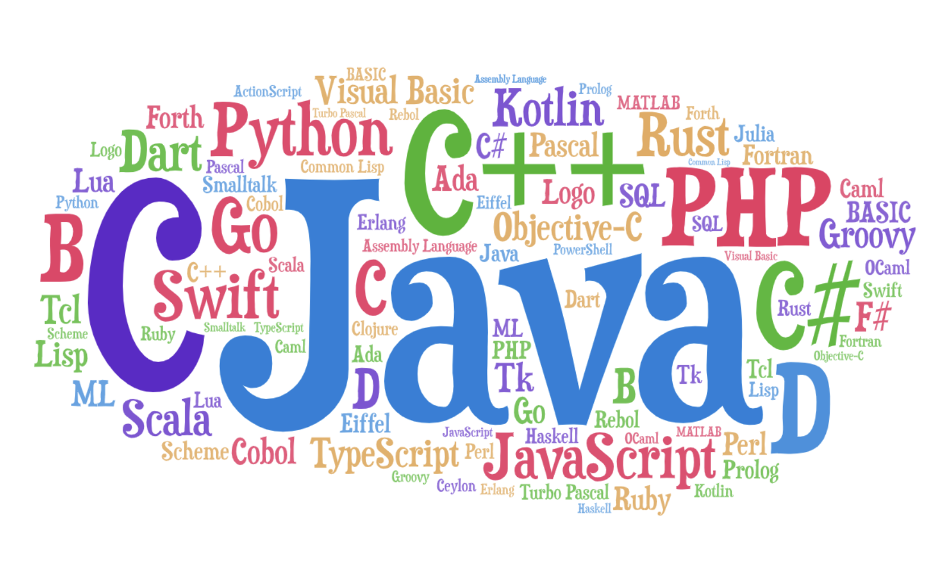
Programming language?
How software tells hardware what to do
Who writes the software? Us
Basically using programming languages we tell the computer what to do
Programming language is nothing but another language that can be used to talk to computers
Just like there are many human languages, there are many computer languages as well

Slide 11
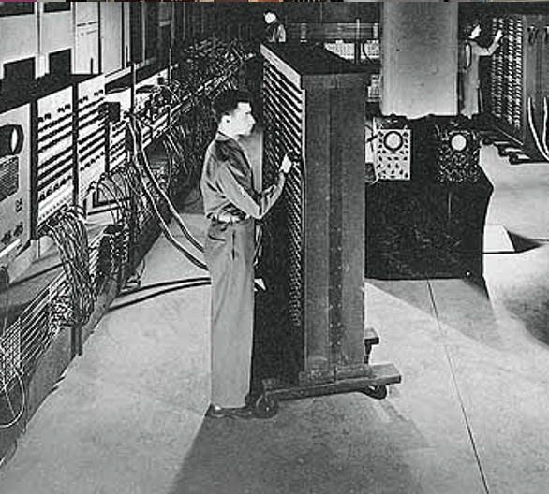
Before programming languages?
Only hardware existed
Computers would process numeric calculations only
They had huge circuitry and by turning voltage High/Low or On/Off, we could tell it what to do
A human would physically have to change the voltages by moving wires or pressing switches

Slide 12
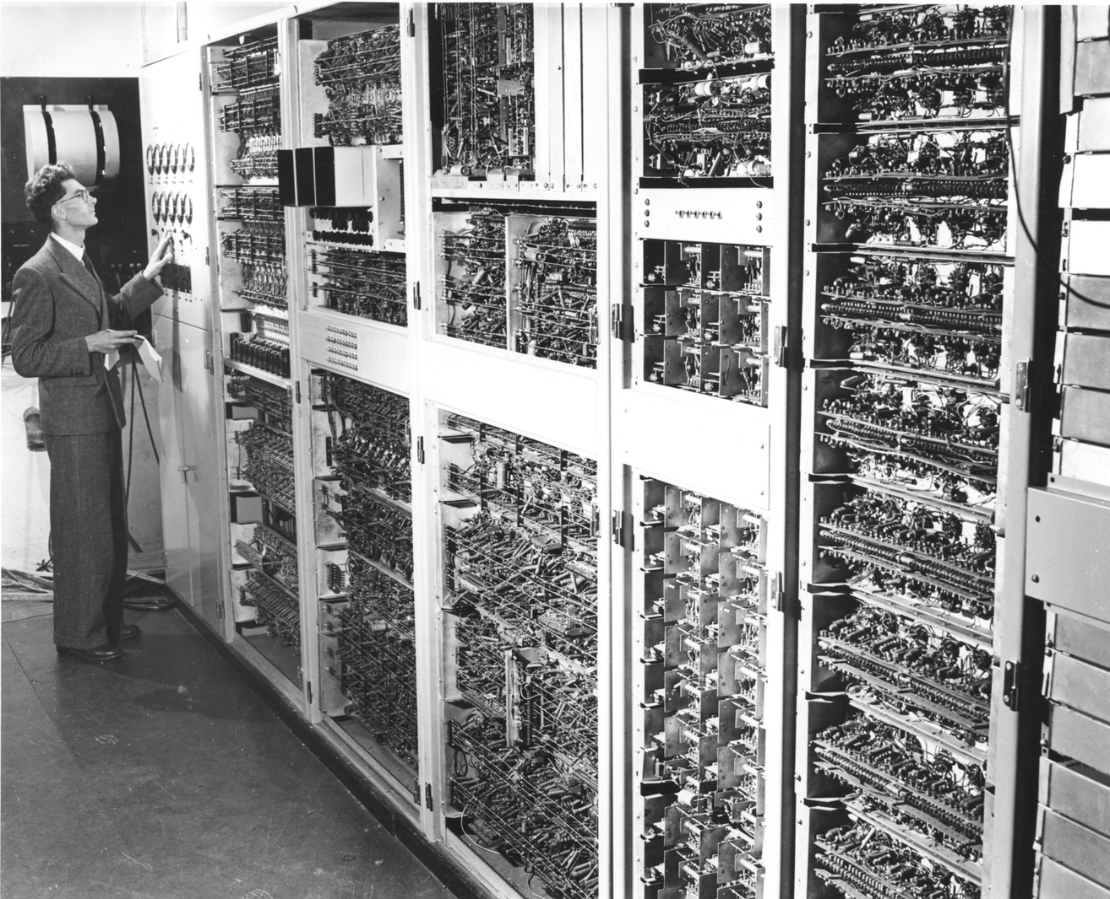
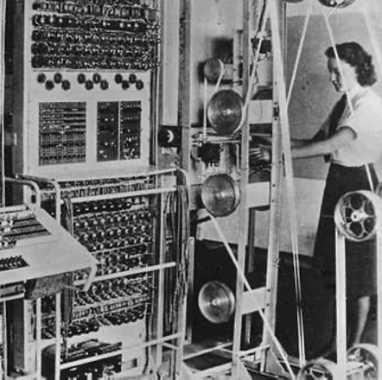
More pictures

Slide 13
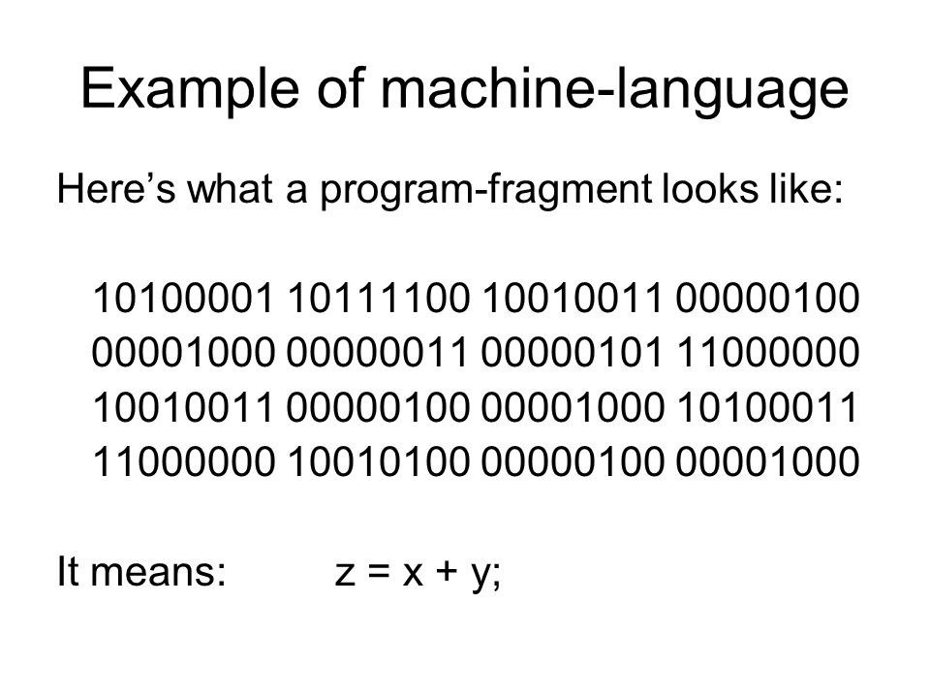
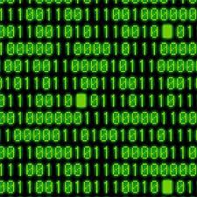
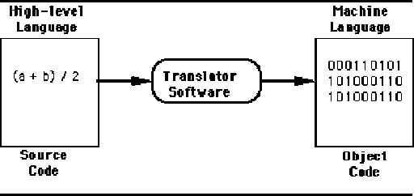
Machine Language
Hardware only understands binary commands, which means either voltage on or off.
So Machine language came which writes in binary to instruct hardware.
Binary only has two digits, 1 and 0
1 means High or On
0 means Low or Off

Slide 14
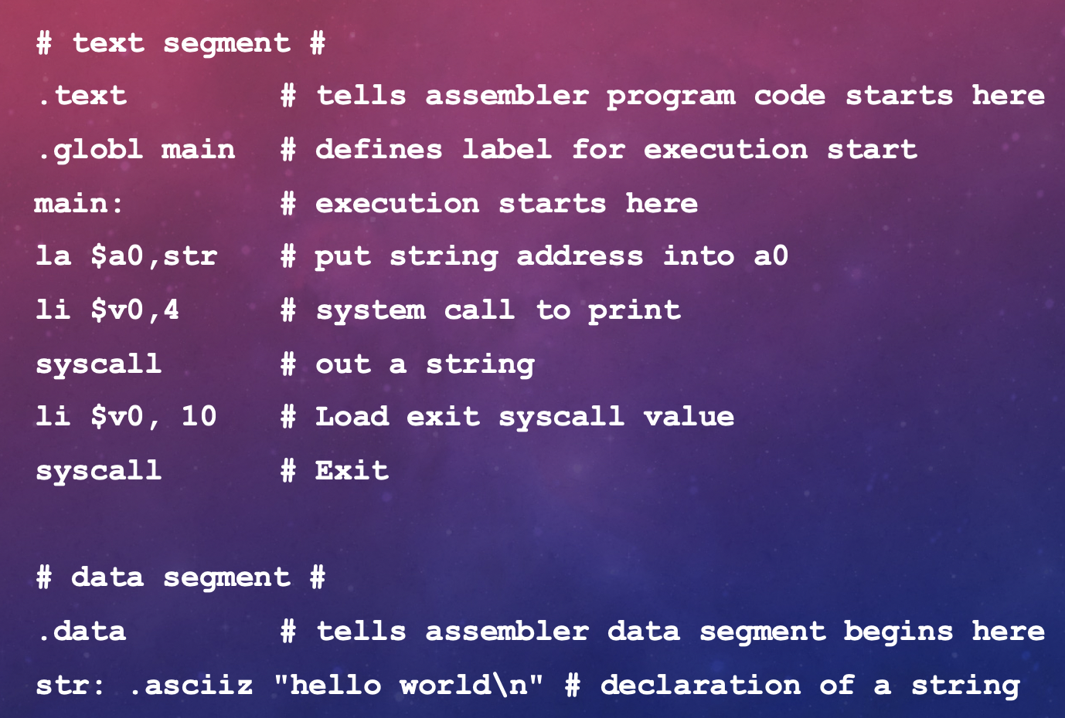

Assembly language
Then came assembly language
Now we can code in text instead of using 1’s and 0’s
Our text gets converted to 1’s and 0’s that hardware understands
But still too lengthy
Hard to do sophisticated things
Ex: Just to write “Hello World”

Slide 15
High Level Language
Assembly was much better than writing binary BUT...
Still far too slow
No sophisticated programs can be written
We need a better and more user-friendly language
Then comes High Level Languages
Examples: Java, C++, Python, HTML, and more

Slide 16
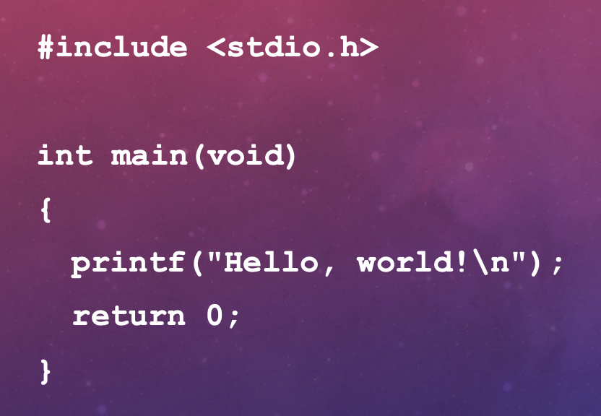
Hello world in C

Slide 17
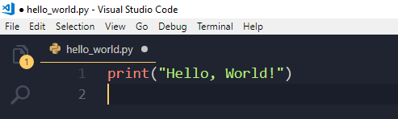
High Level Language
Now we can make games and applications easily
Very close to human languages, but syntax (grammar rules) is different
Ex: “Hello World” in Python
It’s that easy now. We’ve come a long way since machine language

Slide 18
Software setup
Download python 3.8.3
Install Pycharm
As it downloads and installs, we will brainstorm for virtual High Five ideas.

Slide 19
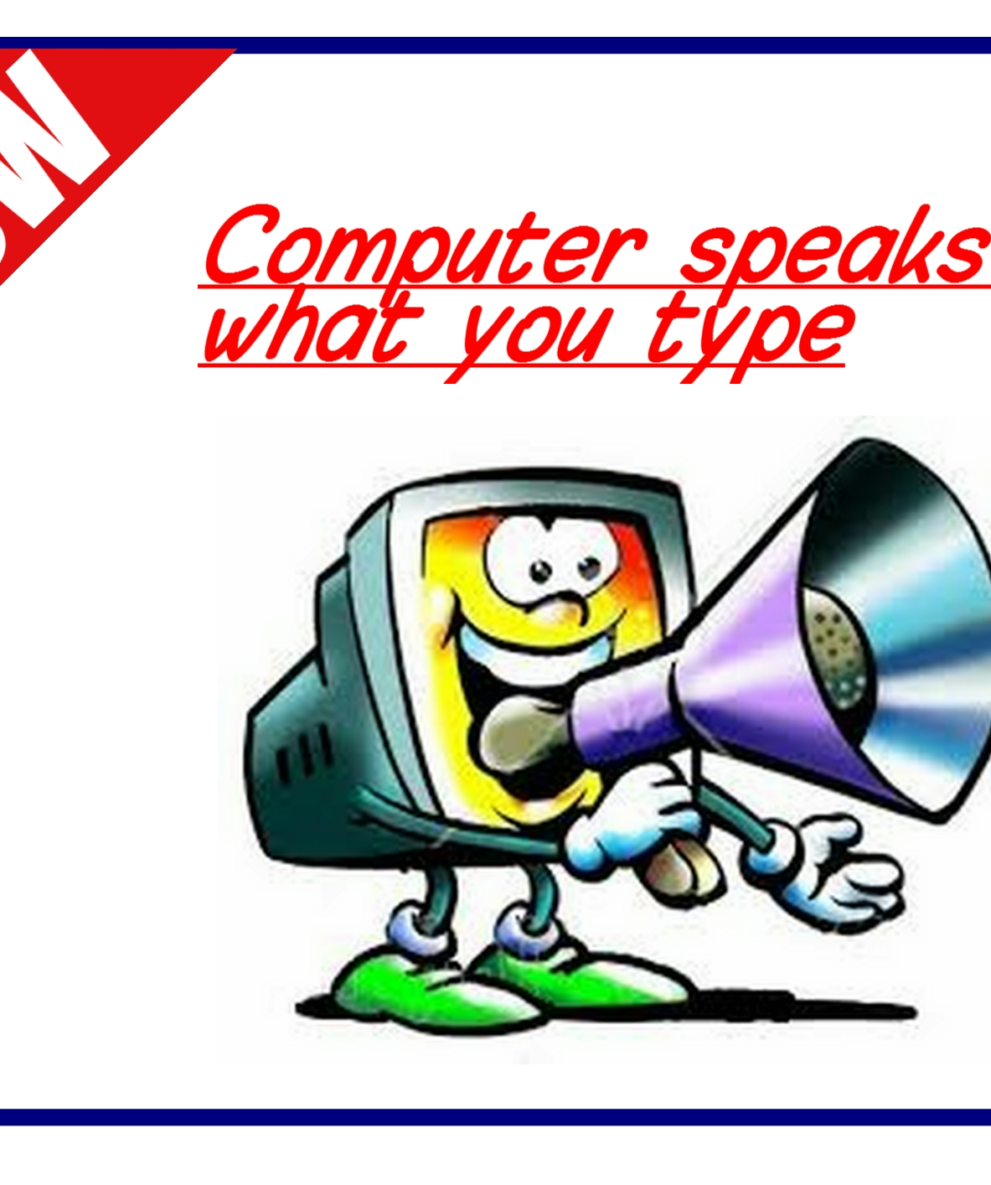
Write our first code
Let’s talk to the computer for the first time!
We will use the print() command
It prints whatever is inside the parentheses
If we want to print a text, we must put it inside “quotation marks”
If it’s a number, we can directly write it inside the parentheses

Slide 20
Tech Talk
Let’s share some tech news, funny facts, innovative machines, cool features in games, or whatever else piques your interest
From me- debug story

Slide 21
Adios
No Homework
Play around a little with the print command if you want to
Bring some tech talk topic for next class
Have a great week!

